Slide 1
Distributed Computing
Logical Time
Dr. Barsha Mitra
CSIS Dept, BITS Pilani, Hyderabad Campus

Slide 2
Introduction
  not possible to have global physical time
  realize only an approximation of physical time using logical time
  logical time advances in jumps
  captures monotonicity property
monotonicity property: if event a causally affects event b, then timestamp of a is smaller than timestamp of b
Ways to represent logical time:
    scalar time
    vector time
Course ID: SS ZG526, Title: Distributed Computing

Slide 3
Logical Clocks
every process has a logical clock
logical clock is advanced using a set of rules
each event is assigned a timestamp
Course ID: SS ZG526, Title: Distributed Computing

Slide 4
Scalar Time - Definition
time domain is the set of non-negative integers
C_{i}:
  integer variable
  denotes logical clock of p_{i}
Course ID: SS ZG526, Title: Distributed Computing

Slide 5

Scalar Time - Definition
Rules for updating clock:
R1: Before executing an event (send, receive, or internal), process p_{i} executes
  d can have different values
  Usually d = 1
R2: When process p_{i} receives a message with timestamp C_{msg}, it
executes the following actions:
  1. C_{i} = max (C_{i} , C_{msg});
  2. execute R1;
  3. deliver the message.
Course ID: SS ZG526, Title: Distributed Computing

Slide 6
Evolution of Scalar Time
1 8 9 10 13 14
p₁
1 7 9 10 12 14
6 7 11 12 13 15 16
p₂
5 11 16
Processes
p₃
4 5 10 11 12 17
3 12
p₄
2 3 4 5 6 13 14
Time
Course ID: SS ZG526, Title: Distributed Computing

Slide 7
Scalar Time – Basic Properties
  Consistency
  Total Ordering
  Event Counting
  No Strong Consistency
  From Recorded Lecture
Course ID: SS ZG526, Title: Distributed Computing

Slide 8
Scalar Time – Basic Properties
1 8 9 10 13 14
p₁
1 7 9 10 12 14
d = 1
height of event
6 7 11 12 13 15 16
p₂
5 11 16
Processes
p₃
4 5 10 11 12 17
3 12
p₄
2 3 4 5 6 13 14
Time
Course ID: SS ZG526, Title: Distributed Computing

Slide 9
Vector Time - Definition
  time domain is represented by a set of n-dimensional non-negative integer vectors
  vt_{i}[i], vt_{i}[j]
Course ID: SS ZG526, Title: Distributed Computing

Slide 10



Vector Time - Definition
p₁
p₂
p₃
p₄
Time
Course ID: SS ZG526, Title: Distributed Computing

Slide 11
Vector Time
      Comparing Vector timestamps from Recorded Lecture
      Vector Time properties from Recorded Lecture
Course ID: SS ZG526, Title: Distributed Computing

Slide 12
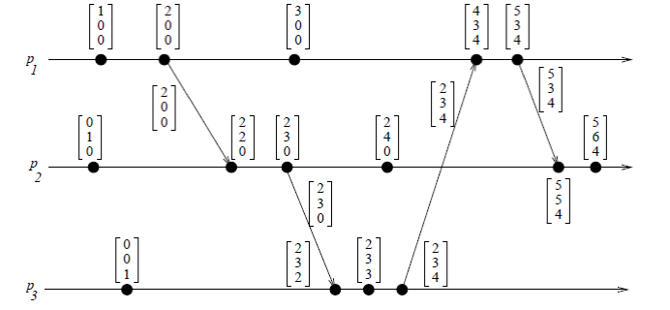
Vector Time – Basic Properties
Event counting
if d is always 1 and vt_{i}[i] is the i^{th} component of vector clock at process p_{i}
  then vt_{i}[i] = no. of events that have occurred at p_{i} until that instant
Course ID: SS ZG526, Title: Distributed Computing

Slide 13
Vector Time – Basic Properties
Event counting
if an event e has timestamp vh
  vh[j] = number of events executed by process p_{j} that causally precede e
  Σ vh[j] −1 : total no. of events that causally precede e in the distributed computation
Course ID: SS ZG526, Title: Distributed Computing

Slide 14
Singhal–Kshemkalyani’s Differential Technique
[1 0 0 0] [2 0 0 0] [3 0 0 0]
p₁
{(1, 1)} {(1, 2)} {(1, 3)}
[2 3 1 0] [3 5 3 1] [3 6 6 3]
p₂
[1 1 0 0] [2 2 0 0] [3 4 1 0]
Processes
{(3, 1)} {(3, 3), (4, 1)} {(3, 6), (4, 3)}
p₃
[0 0 2 1] [0 0 4 2] [0 0 5 3]
[0 0 1 0] [0 0 3 1] [0 0 6 3]
{(4, 1)} {(4, 2)} {(4, 3)}
p₄
[0 0 0 1] [0 0 0 2] [0 0 0 3]
Time
Course ID: SS ZG526, Title: Distributed Computing

Slide 15
Fowler–Zwaenepoel’s Direct-Dependency Technique
reduces the size of messages by transmitting only a scalar value
process only maintains information regarding direct dependencies on other processes
transitive (indirect) dependencies are not maintained by this method
Course ID: SS ZG526, Title: Distributed Computing

Slide 16
Fowler–Zwaenepoel’s Direct-Dependency Technique
[1 0 0 0] [2 0 0 0] [3 0 0 0]
p₁
{1} {2} {3}
[2 3 1 0] [3 5 3 0] [3 6 6 0]
p₂
[1 1 0 0] [2 2 0 0] [3 4 1 0]
Processes
{1} {3} {6}
p₃
[0 0 2 1] [0 0 4 2] [0 0 5 3]
[0 0 1 0] [0 0 3 1] [0 0 6 3]
{1} {2} {3}
p₄
[0 0 0 1] [0 0 0 2] [0 0 0 3]
Time
Course ID: SS ZG526, Title: Distributed Computing

Slide 17
Reference
Ajay D. Kshemkalyani, and Mukesh Singhal, Chapter 3, “Distributed Computing: Principles, Algorithms, and Systems”, Cambridge University Press, 2008.
Course ID: SS ZG526, Title: Distributed Computing

Slide 18

Course ID: SS ZG526, Title: Distributed Computing

